Slide 1


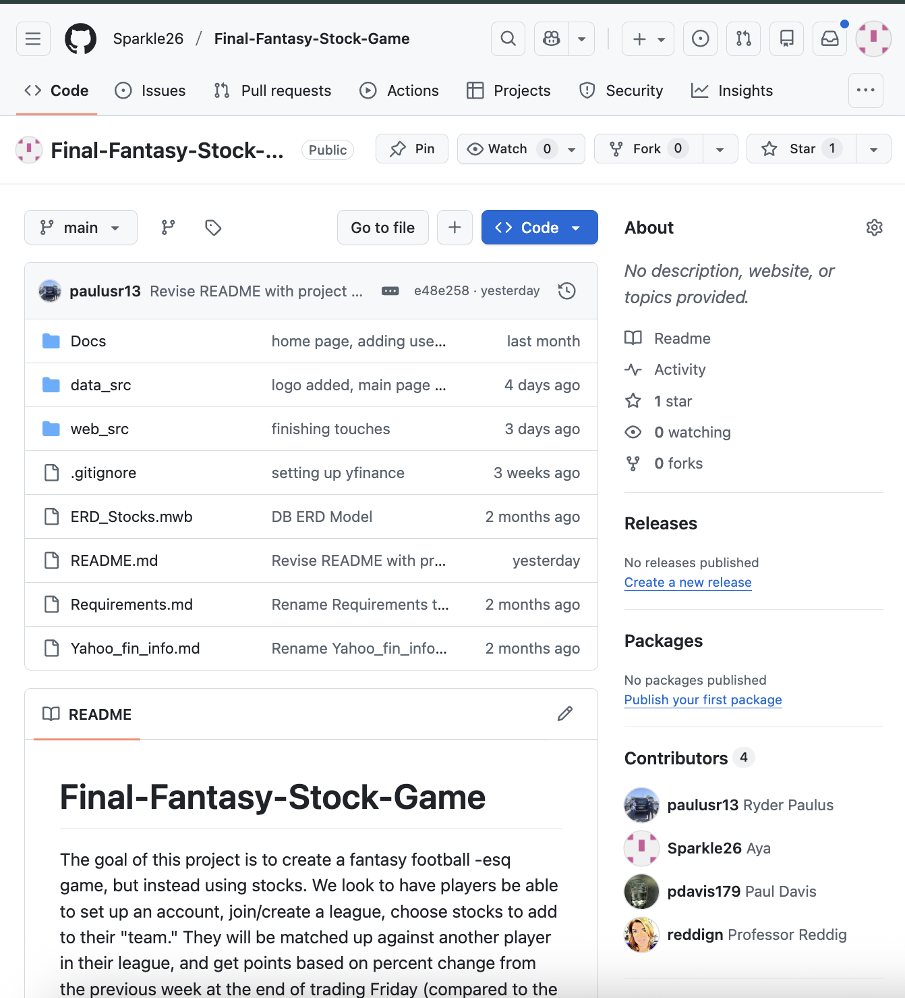
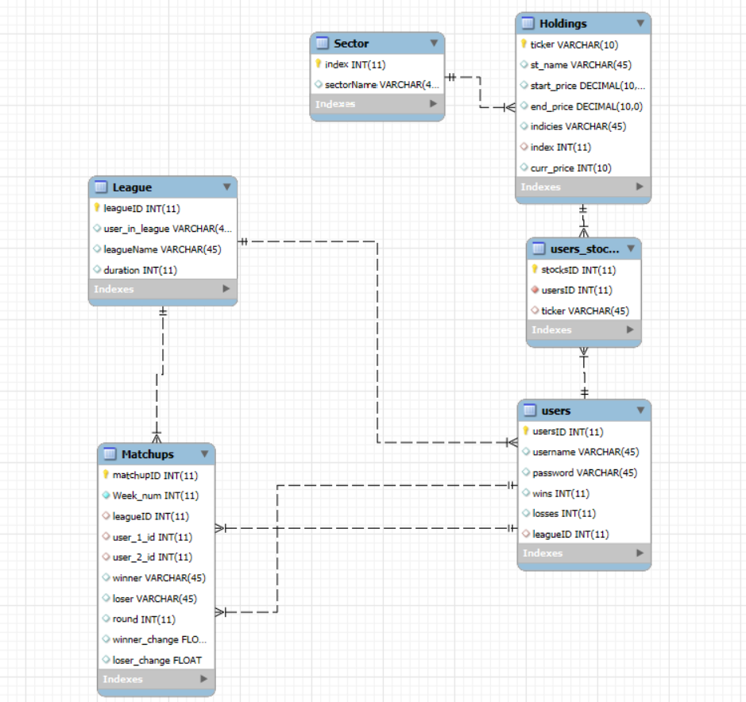
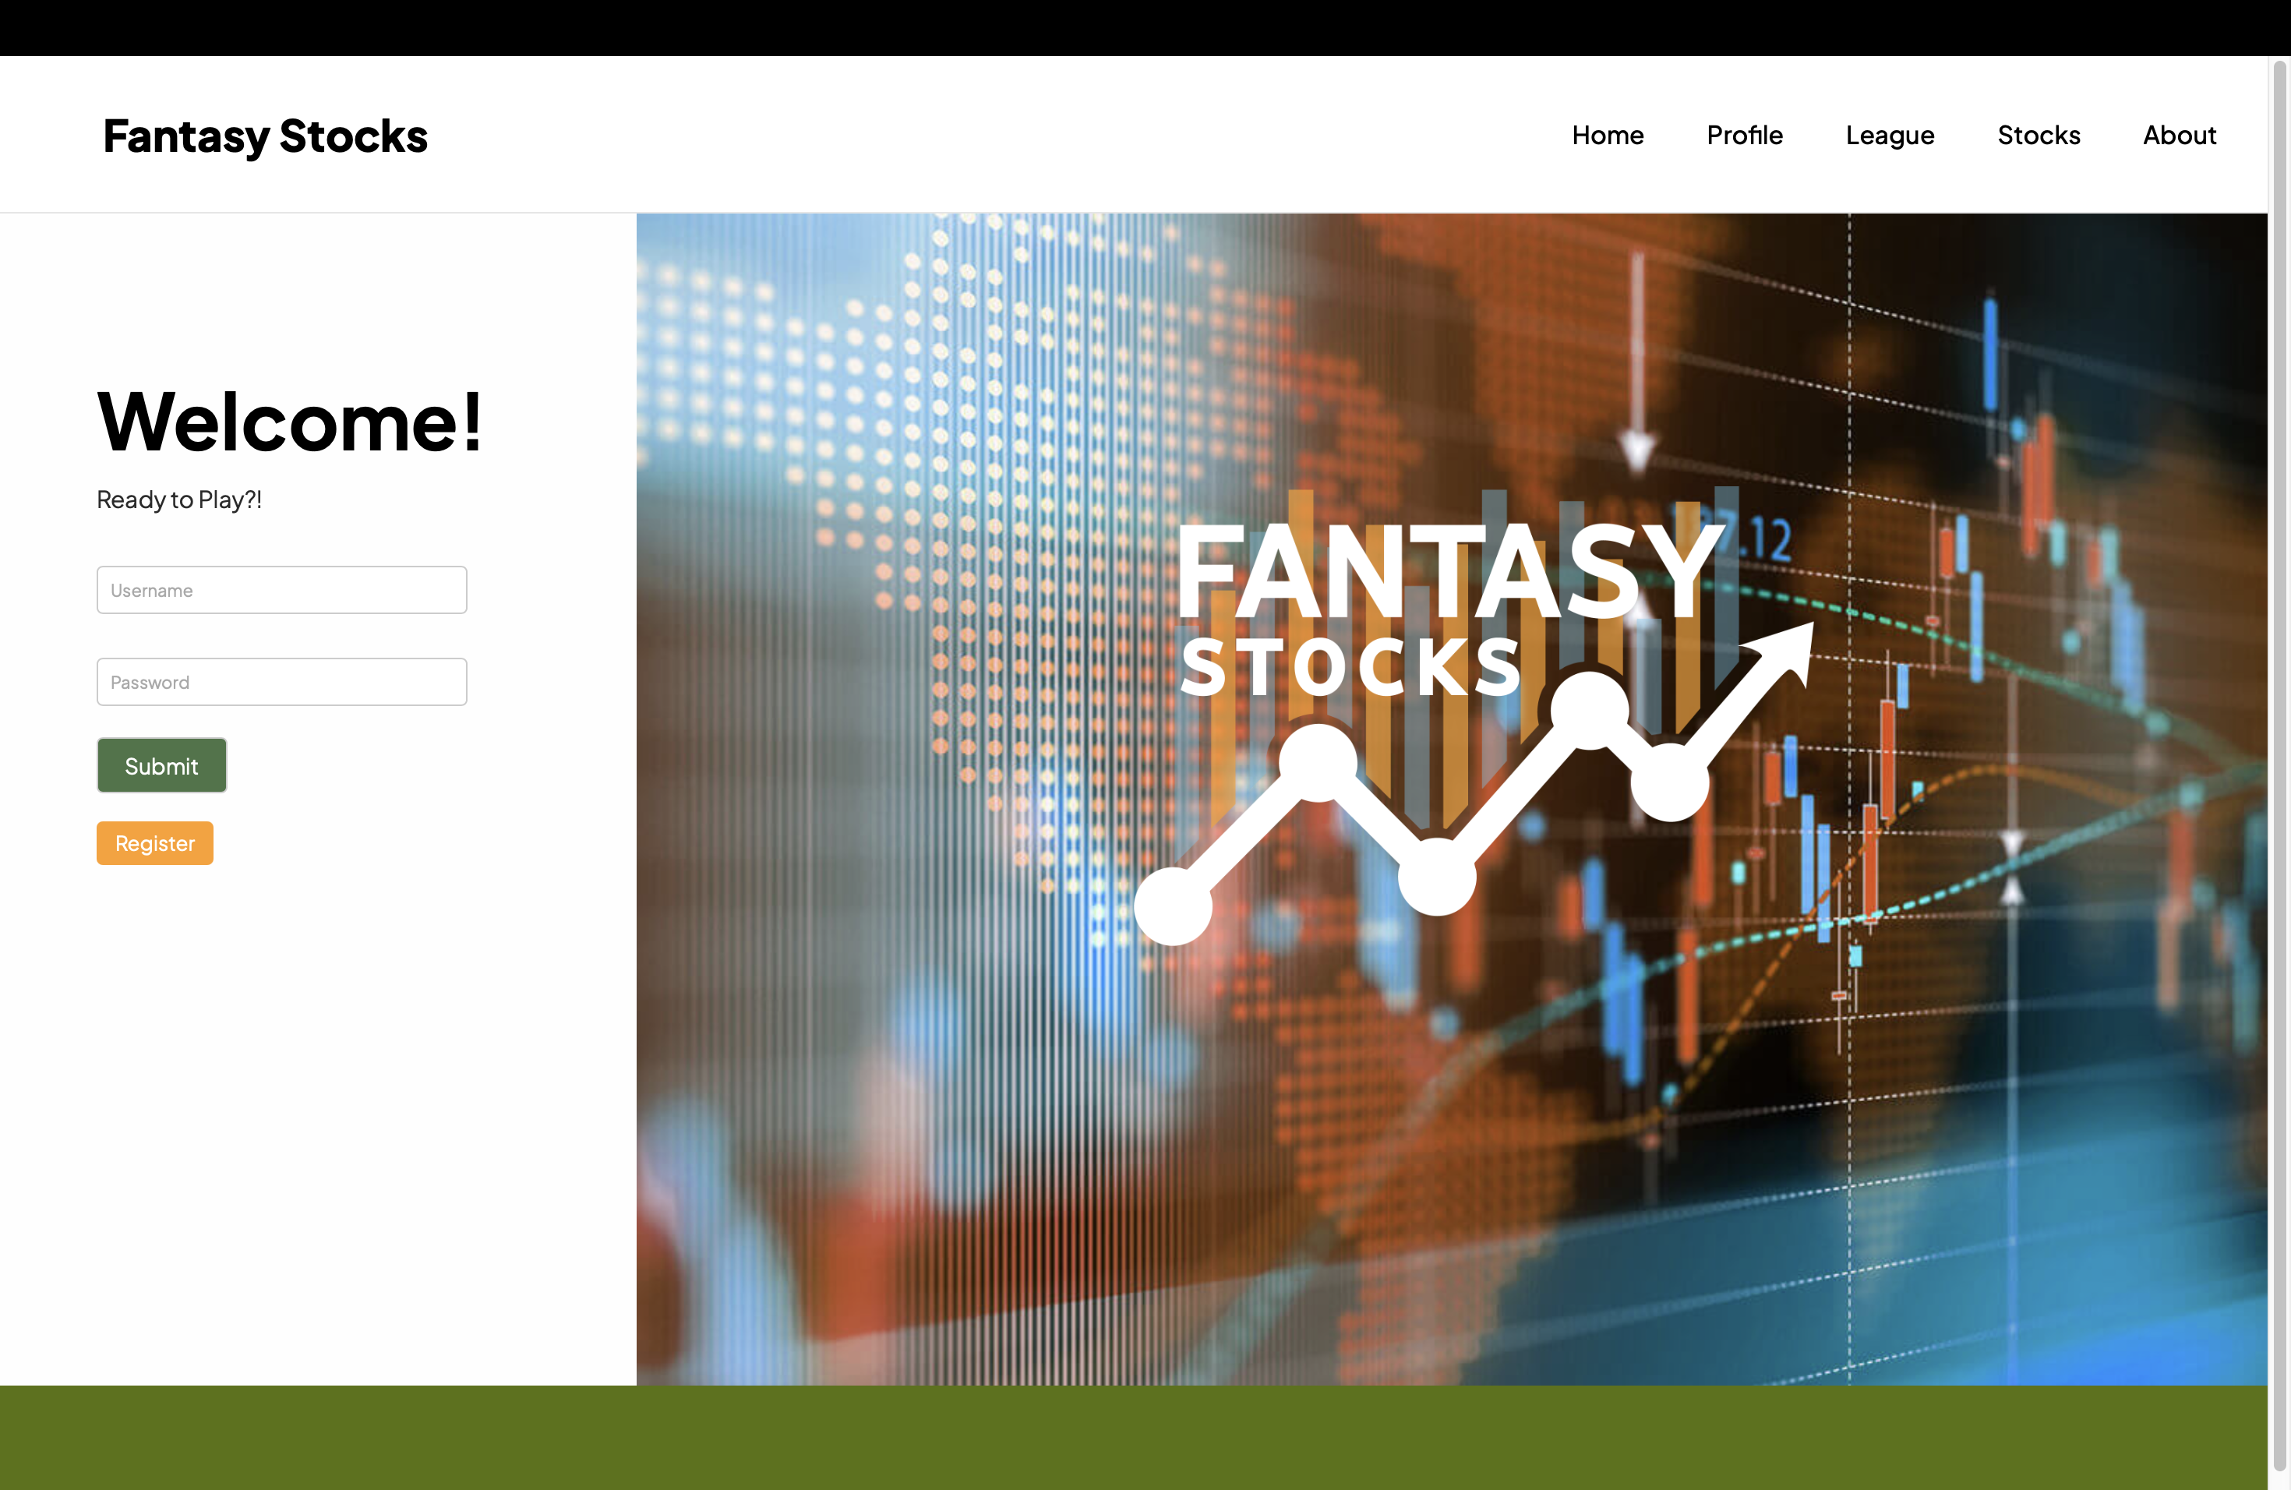
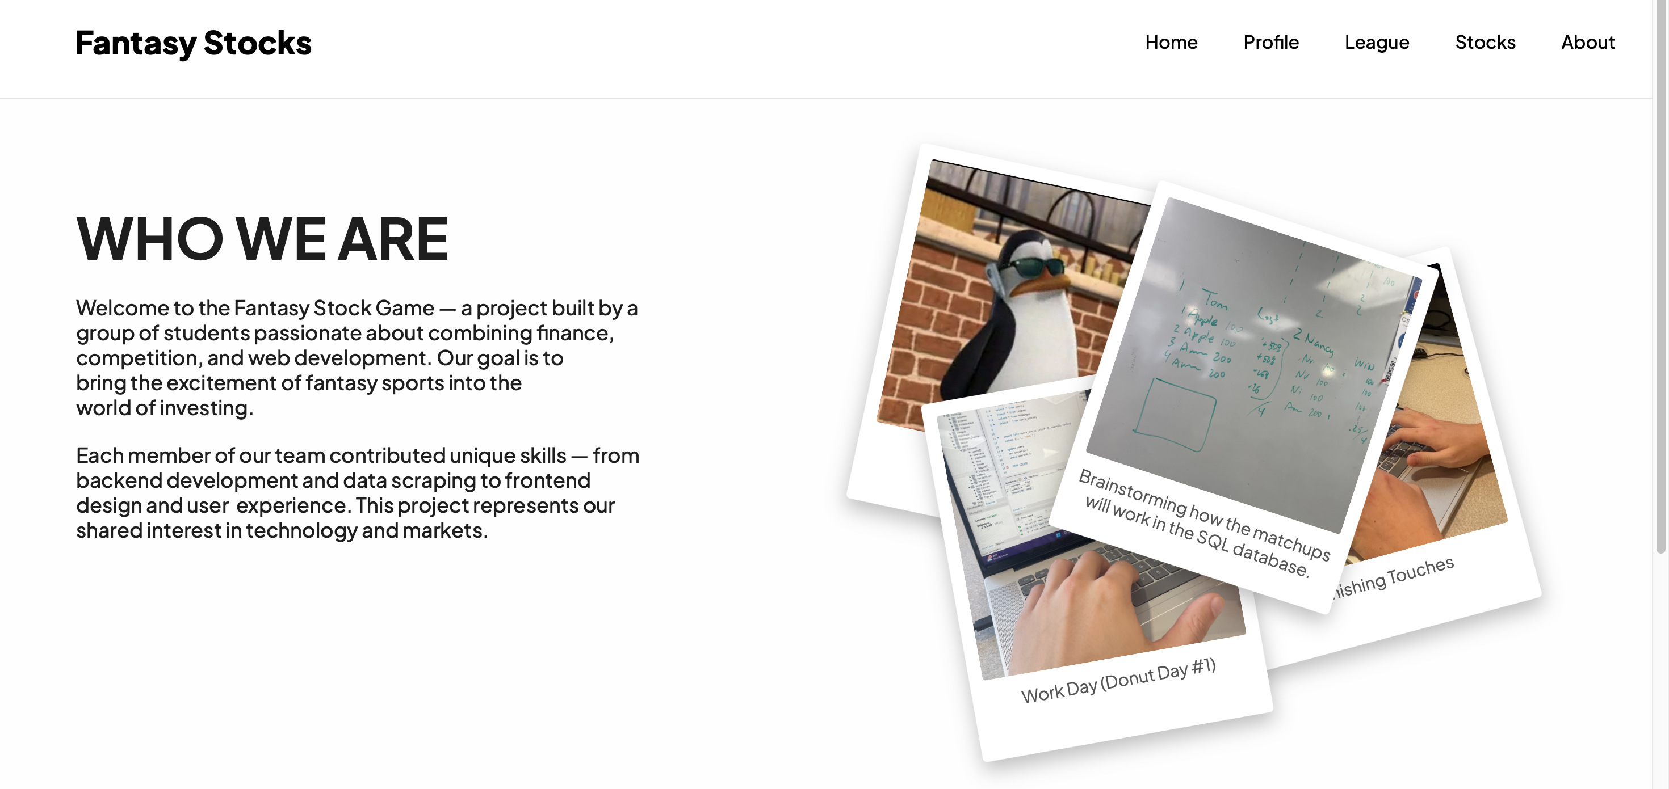
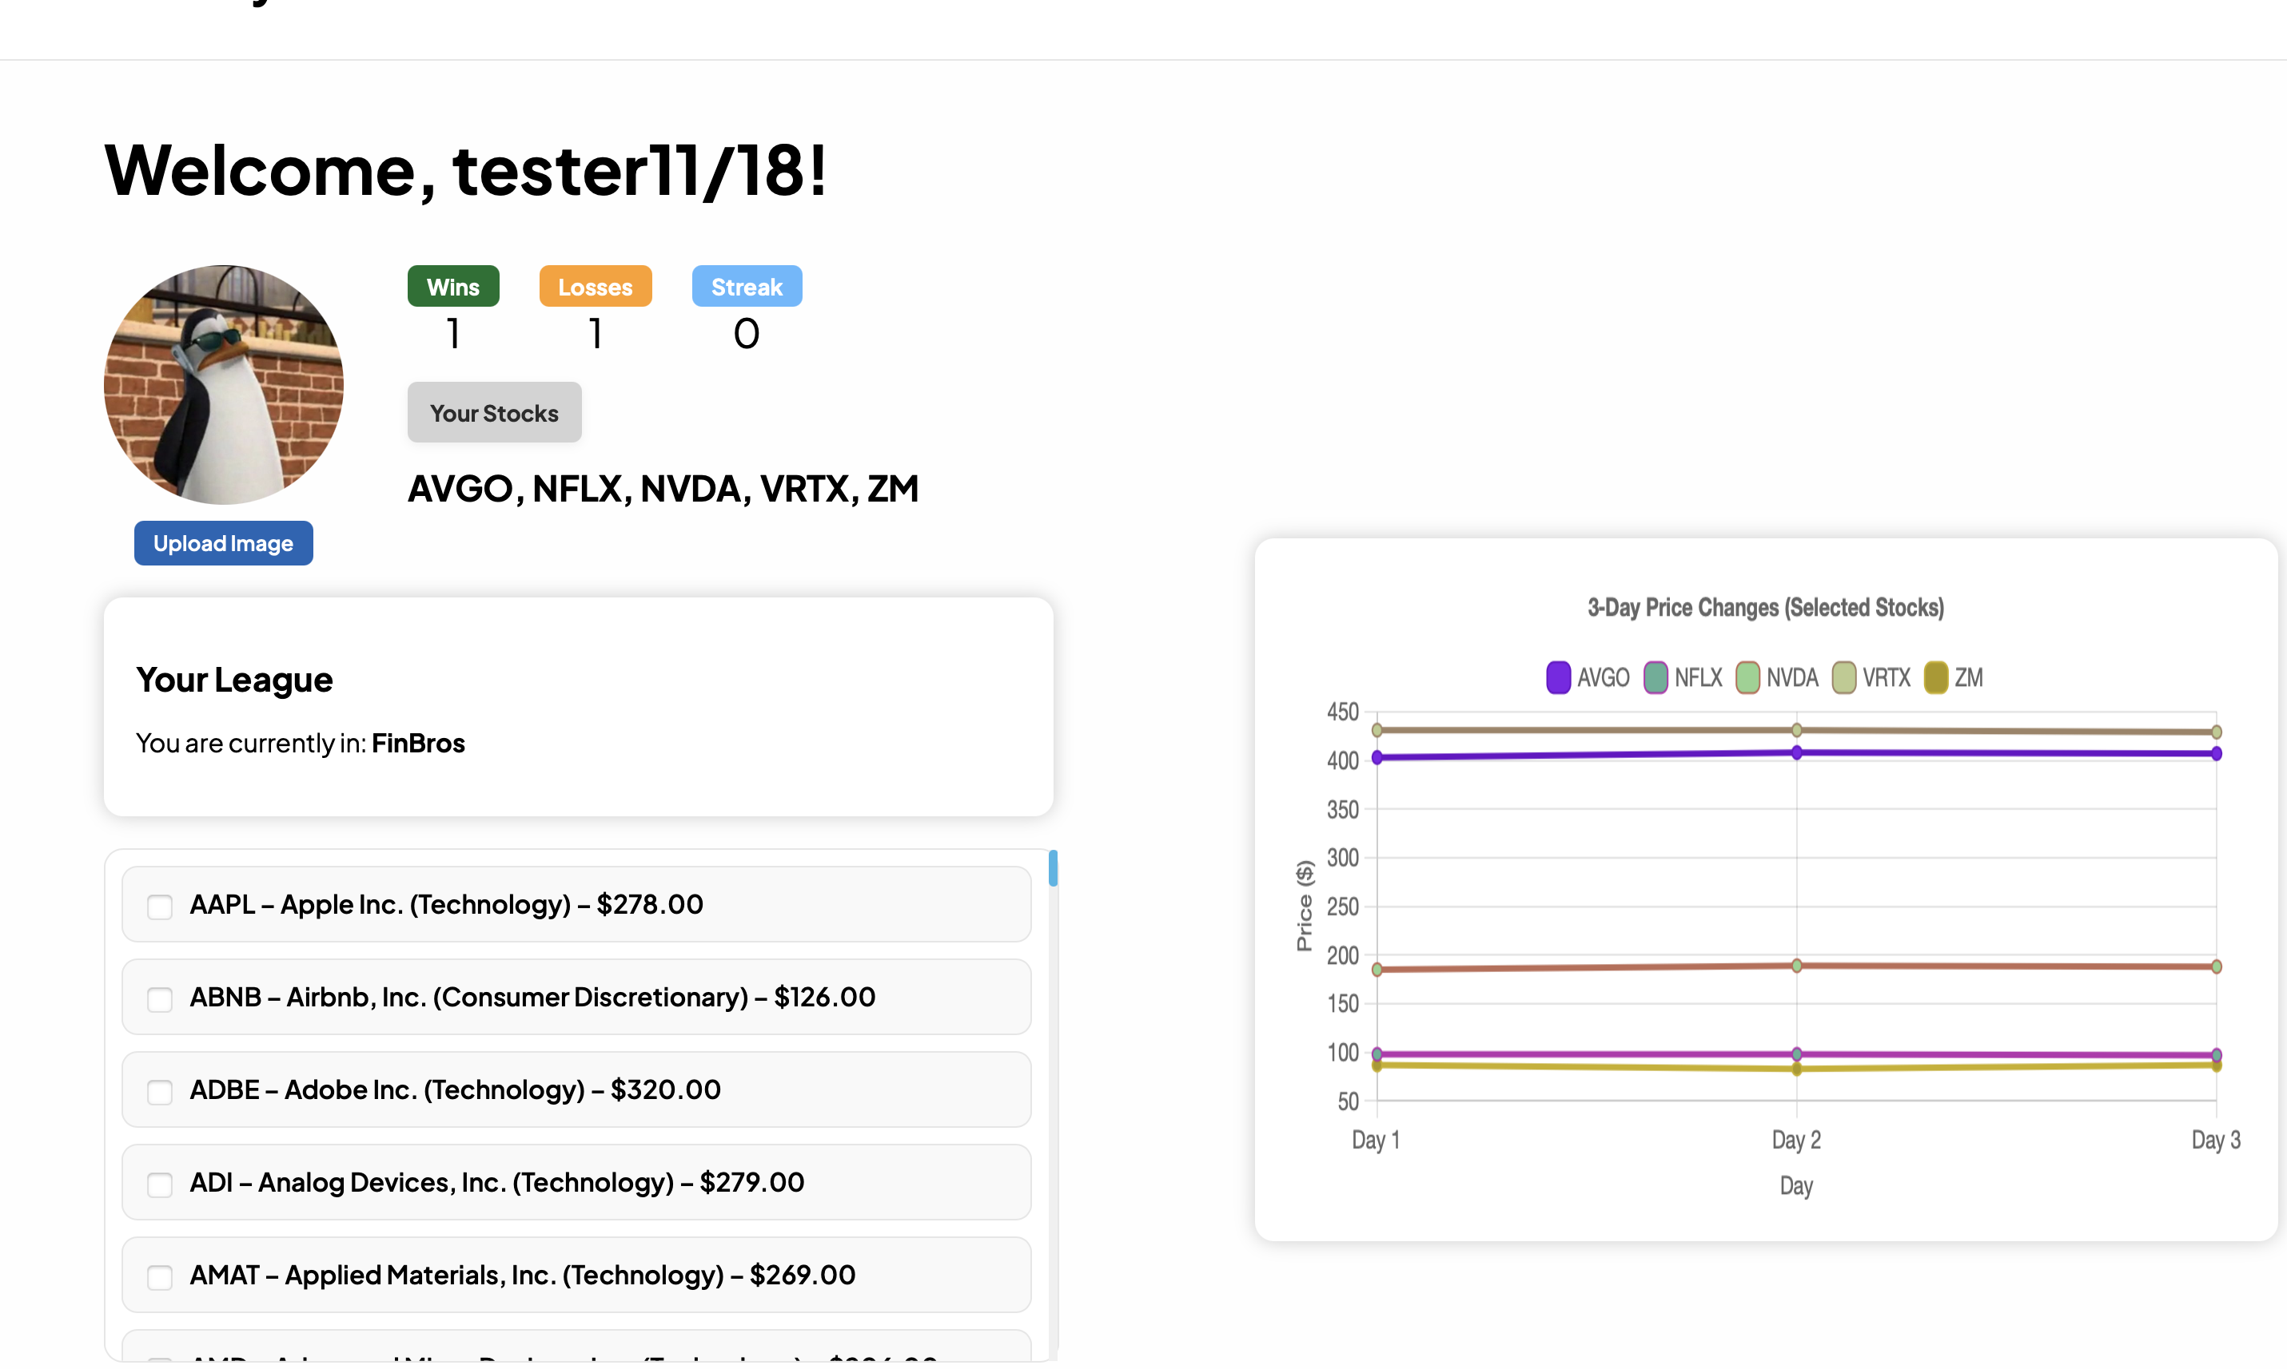
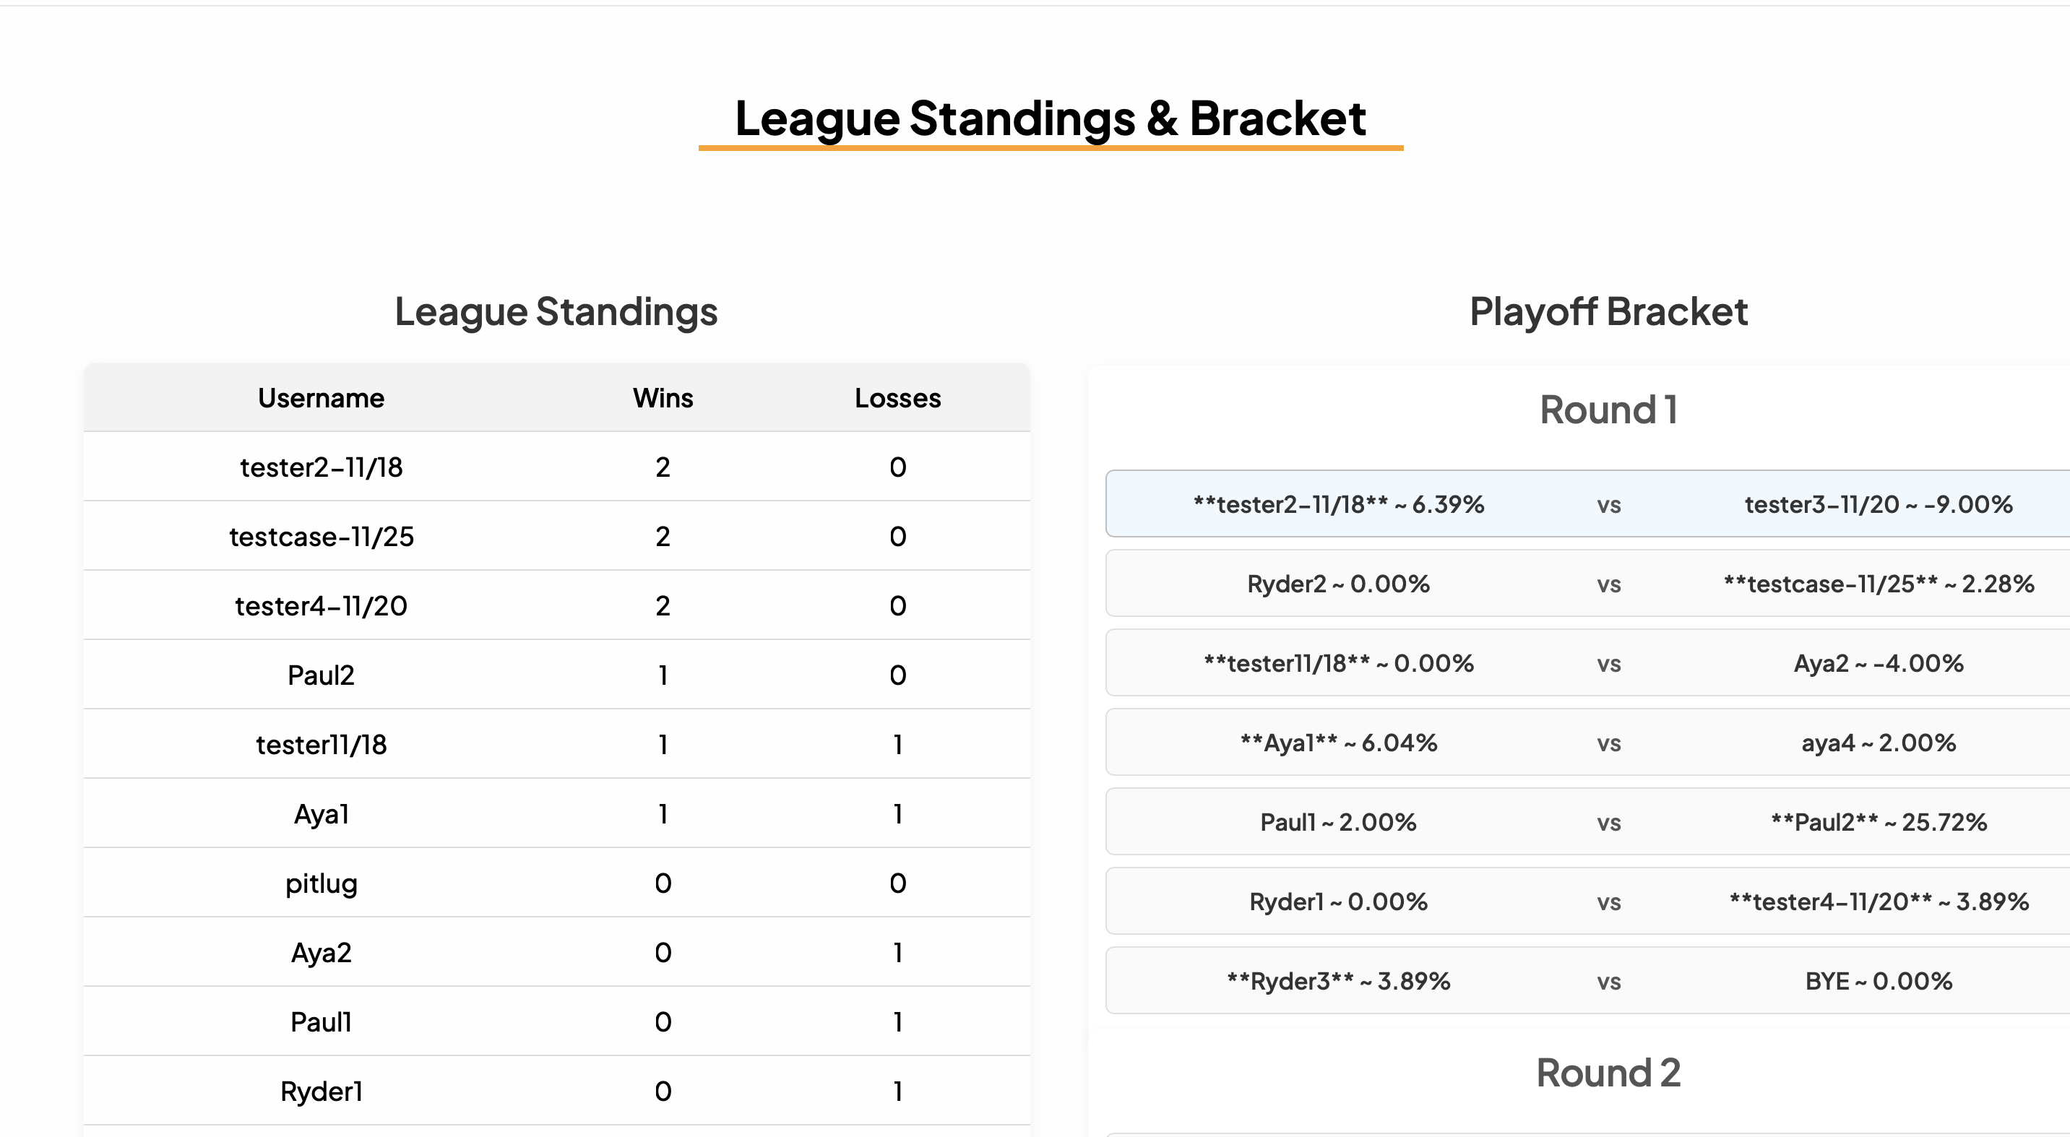
FANTASY STOCKS
Aya Zourgani, Ryder Paulus, Paul Davis
Professor Nancy Reddig, Dr. Sara Atwood
OPPORTUNITY/PURPOSE
TECHNICAL DESIGN & DATA MODEL
Create an interdisciplinary fantasy stock game, akin to Fantasy Football, to allow beginners to gain knowledge and comfort level with the stock market
DESIGN SPECIFICATIONS & SYSTEM REQUIREMENTS
Set up Database, connect to repo, and
provide filler data
Matchup page with User and
Opponent Data
- League Page with Rankings and Bracket
- Stock Scraper task via Python package
Round updater task to move
league forward
User page with league & stock selection
and user data
IMPACT
Our project holds an educational and social impact, helping users learn and gain exposure to finance topics!
Figma Mockups
PROTOTYPE/PROCESS
Our Process: This project began with mocking up our website layout in Figma. We solidified our brand and used it to guide the implementation of our website design.
Key Features: Our website includes key features such as a profile page where users can view their league, stocks, wins/losses/streak, and a developing stock chart of their holdings.
Design Aspects: We selected a color palette that blends the energy of football with the analytical feel of the stock market. Additionally, we chose a bold, professional typeface to reflect the weight and importance of financial decision-making. All colors were selected to complement one another, with blue kept as a
primary element to represent Etown.
TESTING PROCESS
OR LESSONS LEARNED
REFERENCES & ACKNOWLEDGEMENTS
Throughout the project, we learned a lot about working within a team and collaborating effectively through GitHub. We worked together to ensure our Git merges were seamless. We also developed our ability to use Trello to stay organized and keep track of our progress.
Thank you to Professor Reddig and TA John for your help throughout this project and course. We would also like to internally thank our team members. A special thanks to Teddy for helping with Aya’s various challenges with Git.
Software Engineering Project 2025
EDUCATE FOR SERVICE. ENGINEER FOR SOCIETY.
Notes:
Introduction. Include the student name, company name, internship location, internship position, and internship dates. Also note the course rubric and number, course title, and instructor(s). In addition, describe how you secured the internship.
Abstract. The abstract should provide a concise summary of what was done and learned in the internship and the course.
Learning Objectives. List 2 to 5 learning objectives that you had planned to achieve by completing the internship.
Description of Key Responsibilities. Summarize the major responsibilities, activities, and project(s) completed during the internship.
Application of VWU courses to the internship. Explain how your coursework helped with the internship. Link relevant courses, theories, and concepts to their applications within the internship.
Lessons Learned. Explain what you learned about the industry, the company, the career process, and yourself through the internship experience.
Acknowledgements. Recognize the people who helped you, including the internship site supervisor, the course instructor, and mentors. Include full titles in the acknowledgements. In addition, acknowledge funding sources.
Visuals. Incorporate visual aids to illustrate key points. Be sure to label all visuals. Include: names, dates, locations, and photographers. Do not include photographs of children unless you have secured approval from your site supervisor to use the children’s images.

